Slide 1
Postural representations of the hand in primate sensorimotor cortex
James Goodman
Bensmaia Lab
02/11/2019

Slide 2
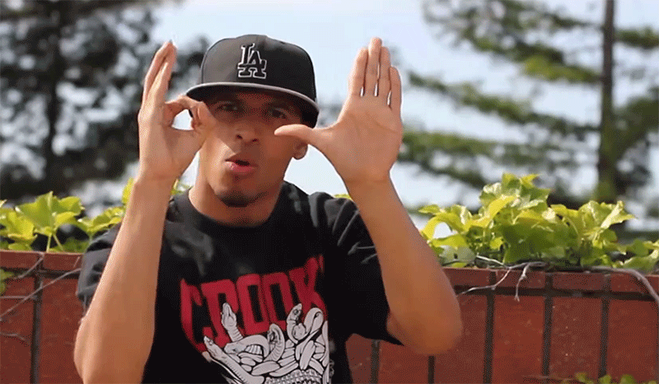
The versatile hand
Notes:
JayFunk (Julian Daniels): apparently the dude who was commissioned to help design dr. strange spellcasting

Slide 3
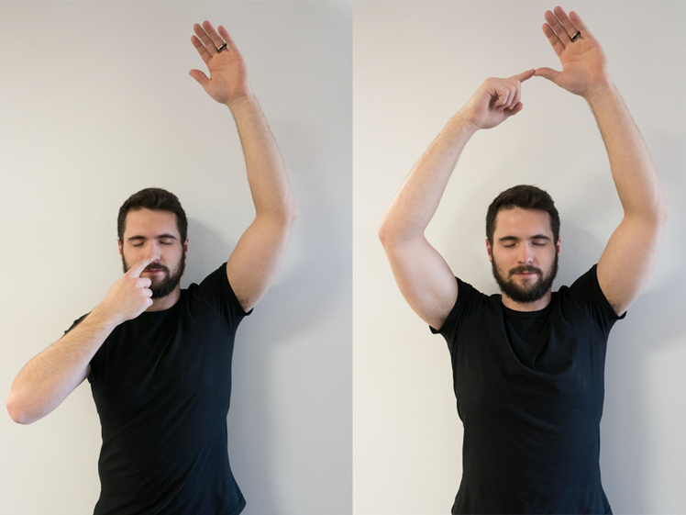
The sense of proprioception

Slide 4
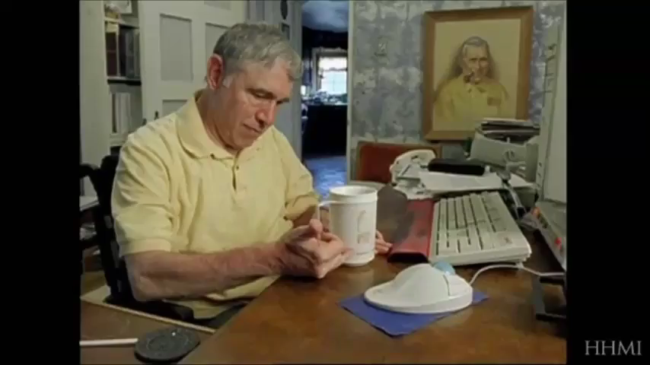
Hands need sensory feedback

Slide 5
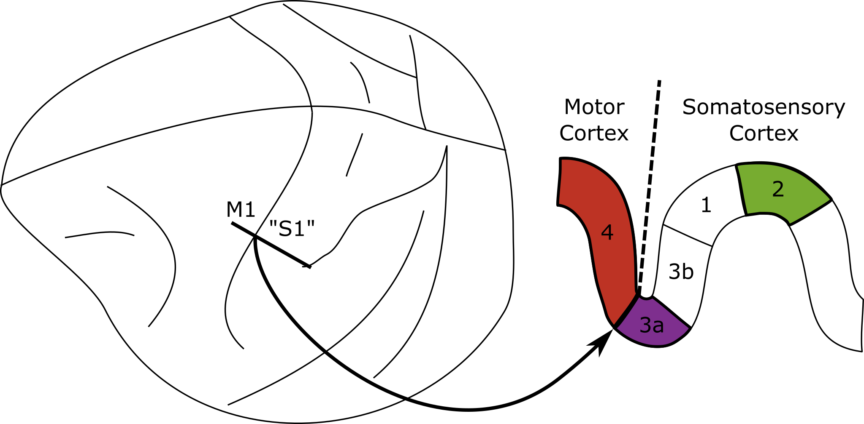
Sensory and motor cortex

Slide 6
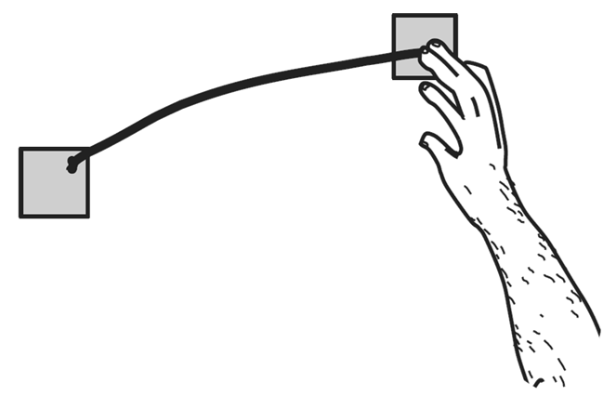
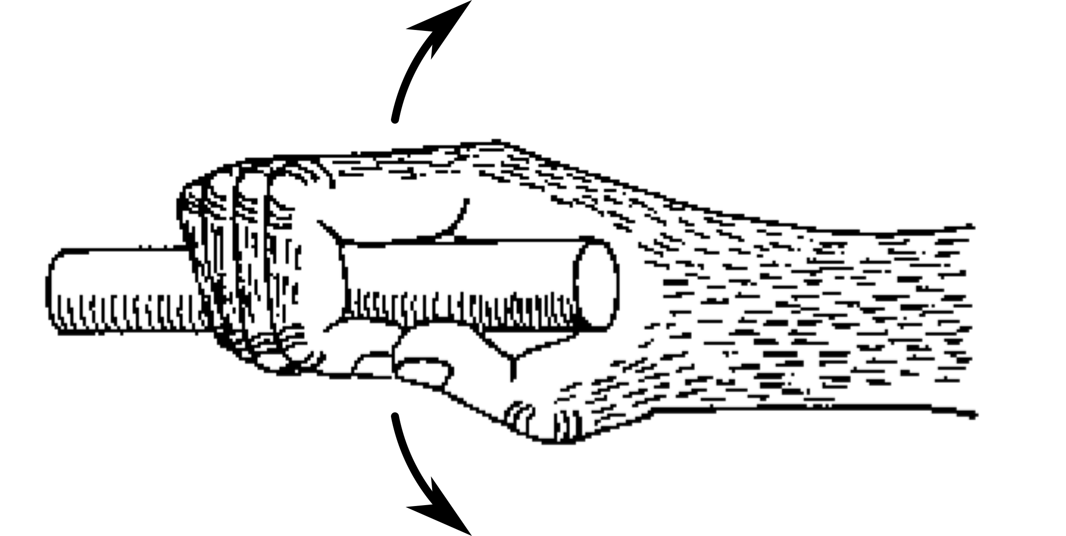
Most neural coding research
Notes:
In the motor system anyway.

Slide 7
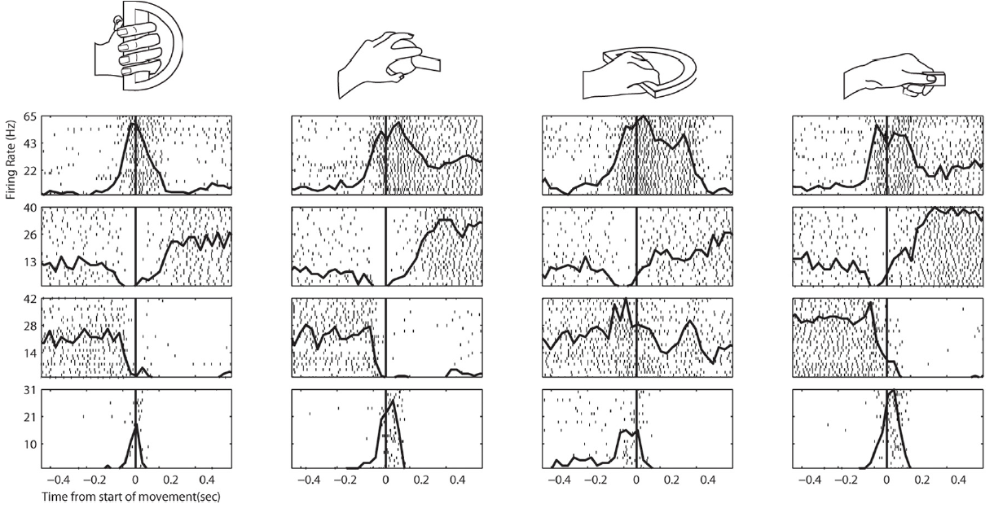
Is it the same for the hand?

Slide 8
Experiment

Slide 9
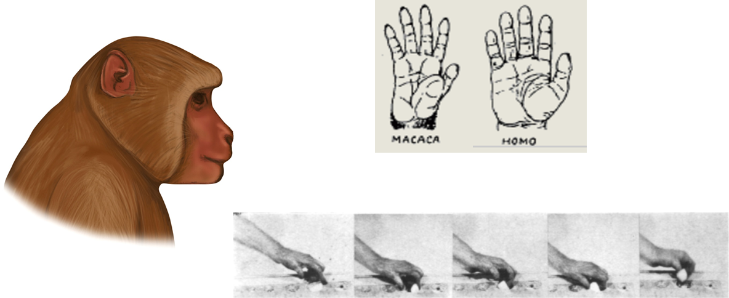
Monkeys have versatile hands

Slide 10
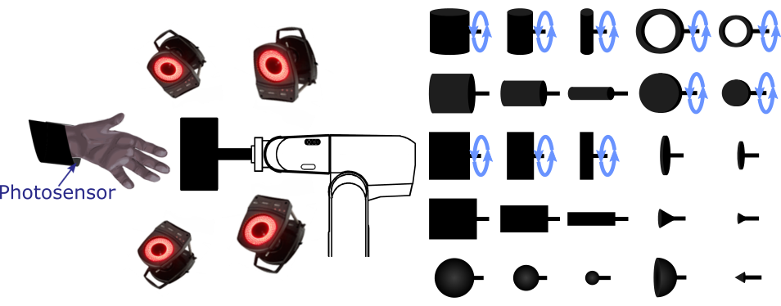
Behavior

Slide 11
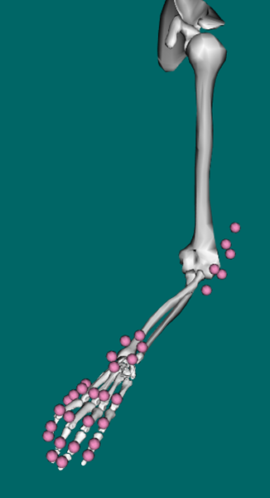
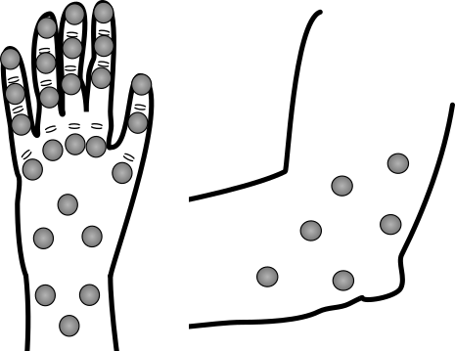
Hand movement recordings

Slide 12
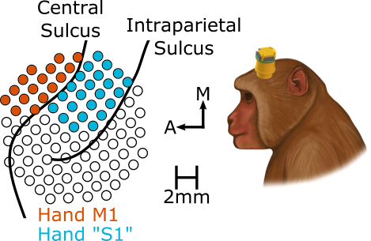
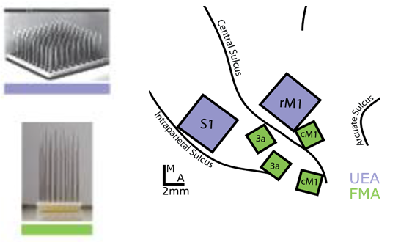
Cortex implants

Slide 13
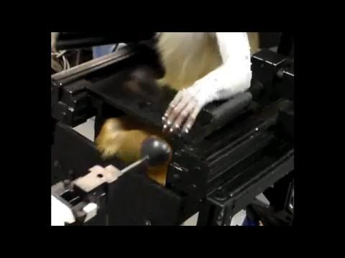
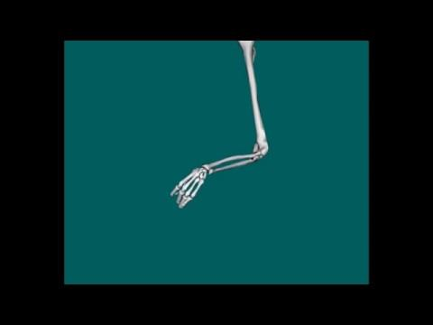
Task in action

Slide 14
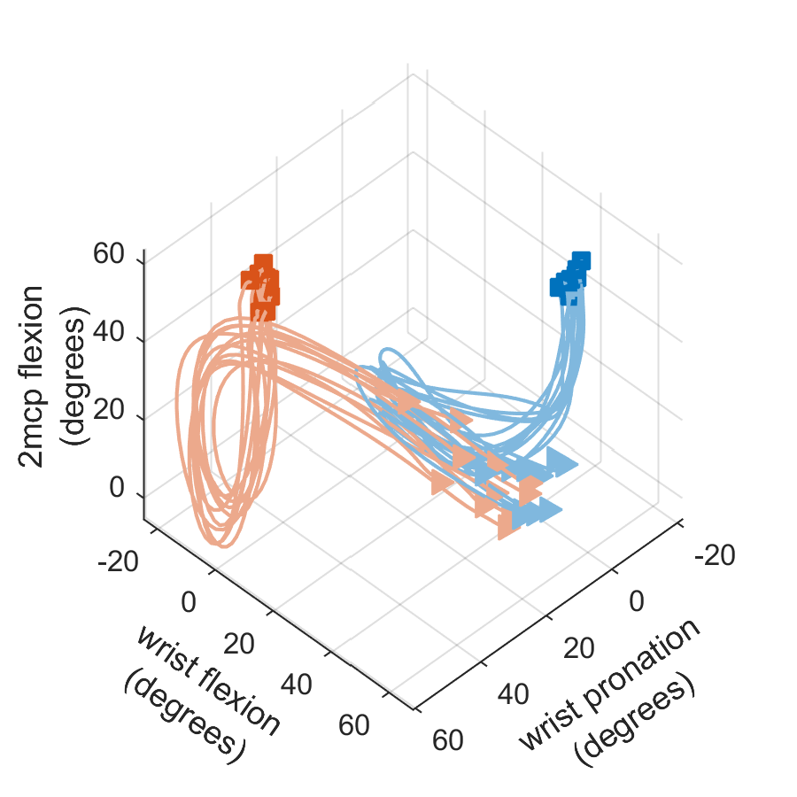
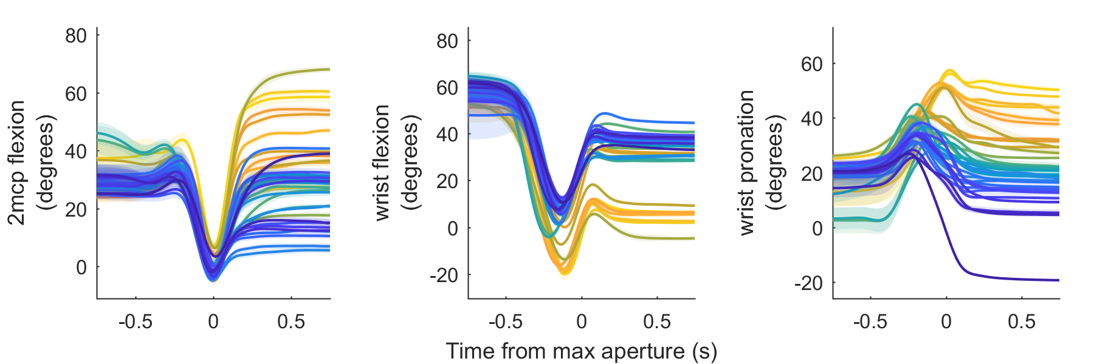
Hand movement variety

Slide 15
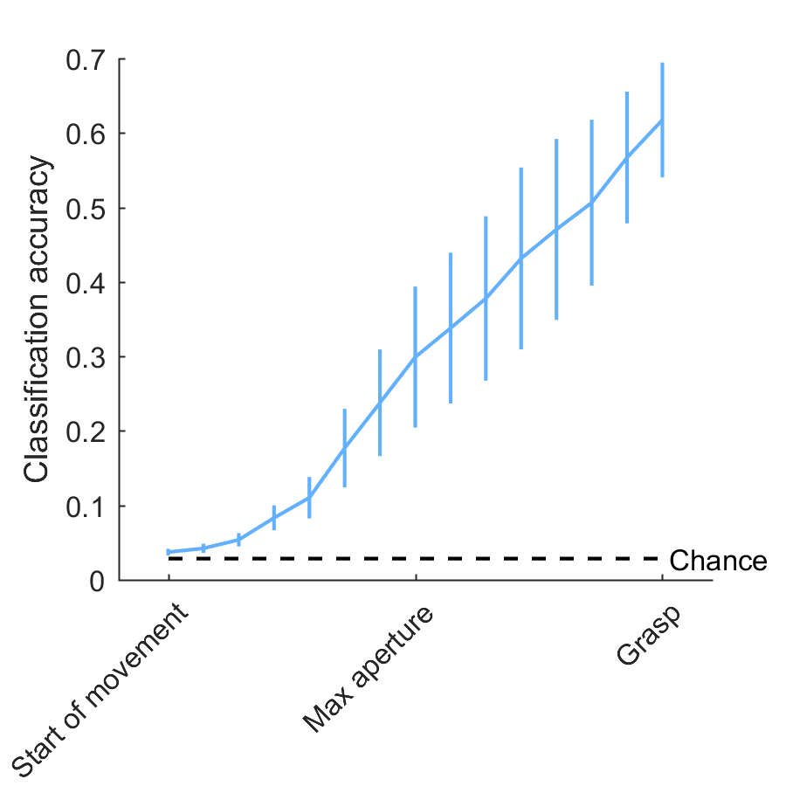
Hand movement variety

Slide 16
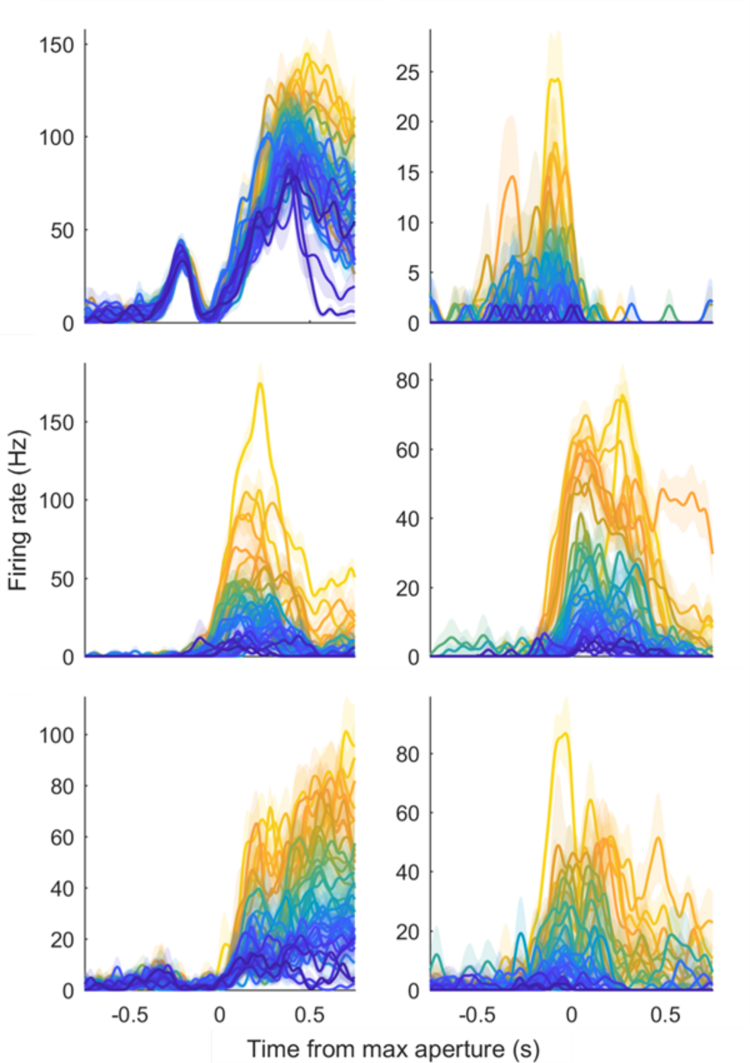
Neural response variety

Slide 17
Analysis and Results

Slide 18
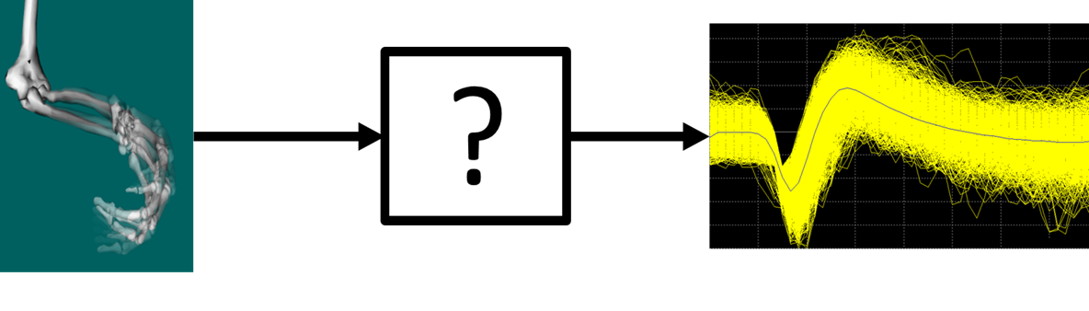
Finding a neural code

Slide 19
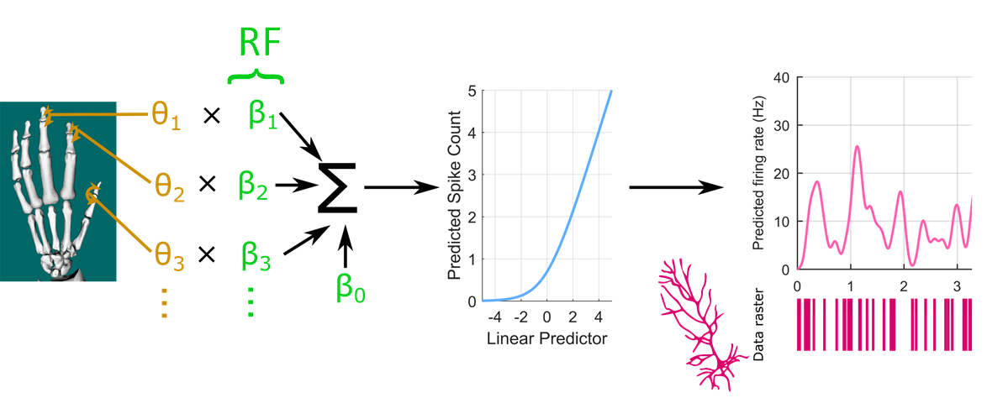
Generalized linear model

Slide 20
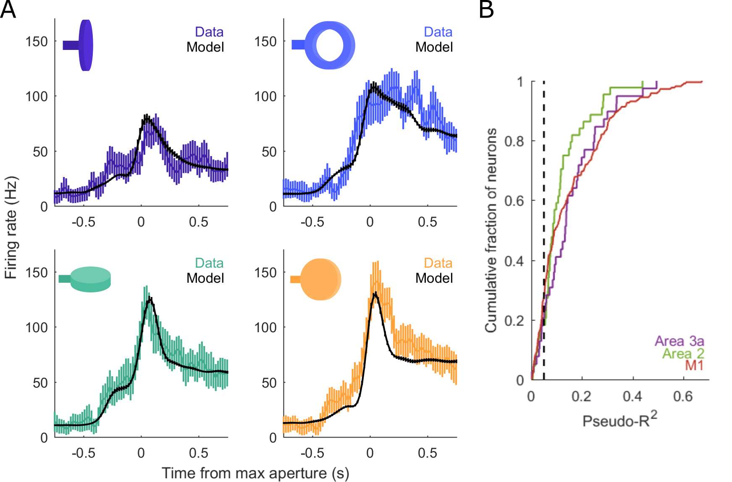
Goodness-of-fit

Slide 21
Receptive field (RF) sizes

Slide 22
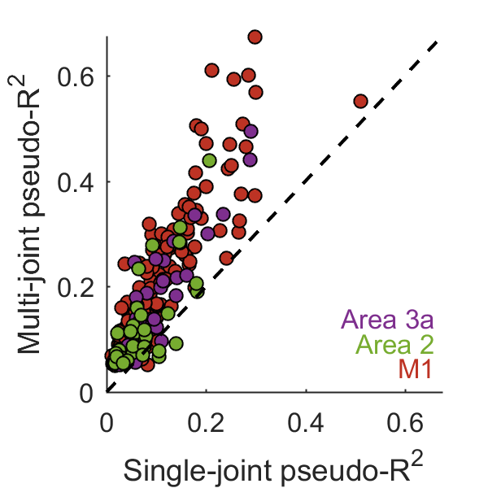
RFs are larger than a single joint

Slide 23
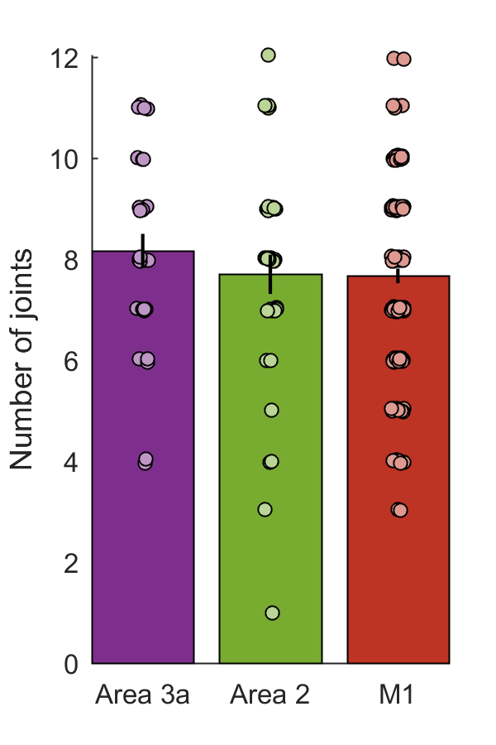
RFs are large

Slide 24
Other possible codes

Slide 25
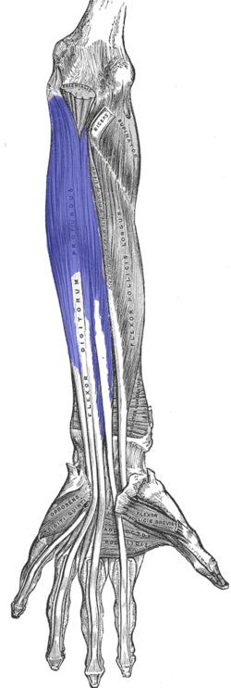
Muscles

Slide 26
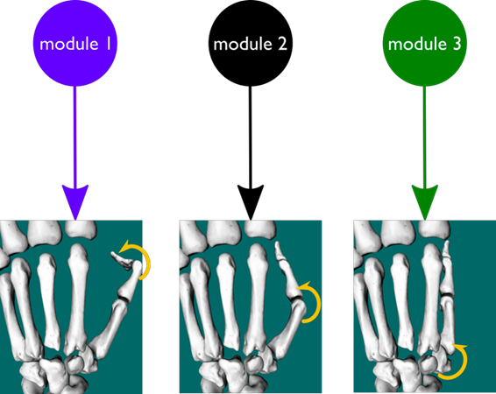
Synergies

Slide 27
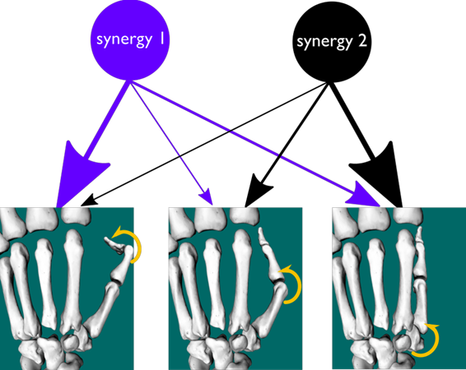
Synergies

Slide 28
What could a “good code” mean?
“Labeled line”?
Neurons track fewer muscles or synergies

Slide 29
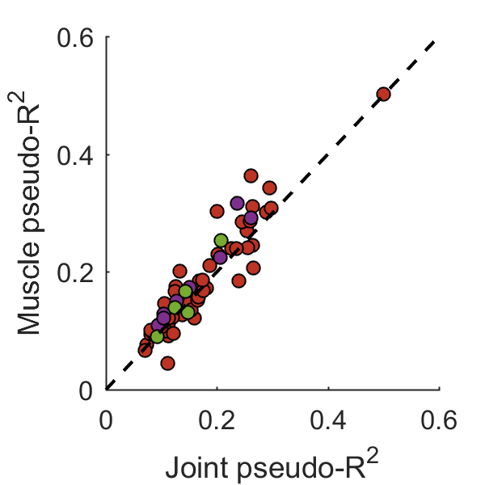
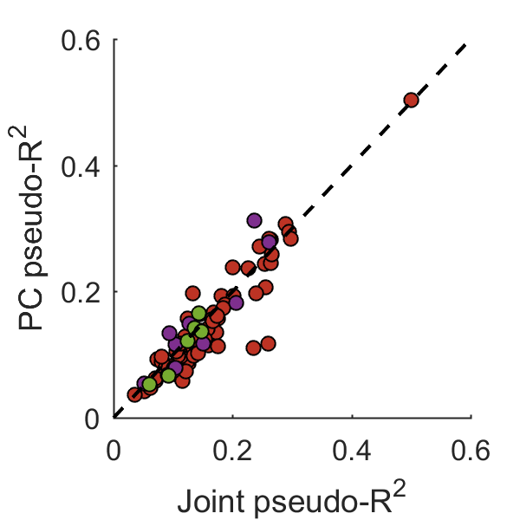
Single muscles or synergies: barely a difference

Slide 30
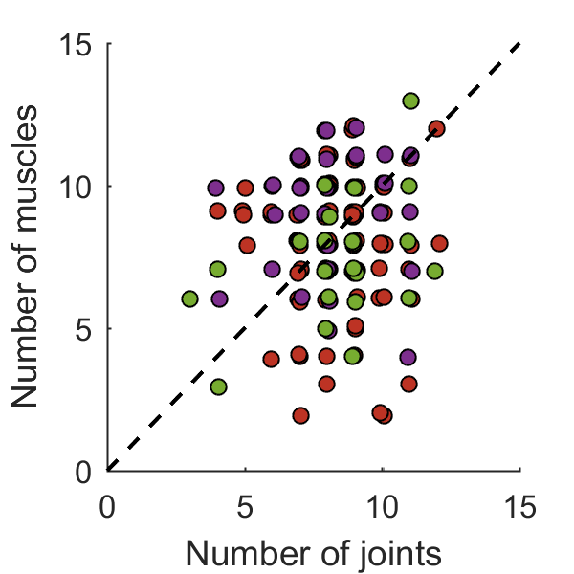
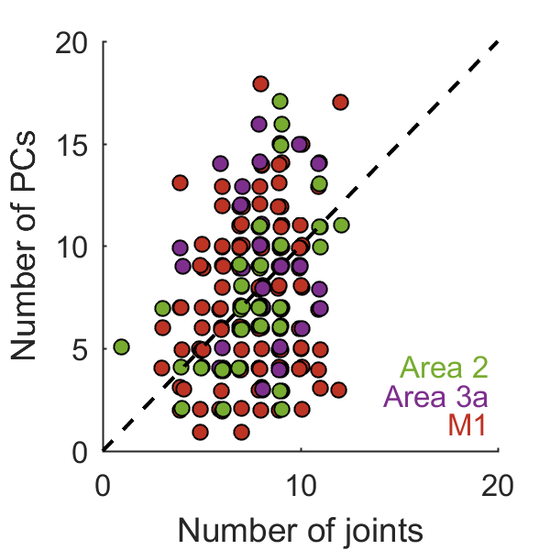
Multiple muscles or synergies: no fewer

Slide 31
Postures vs. Movements

Slide 32
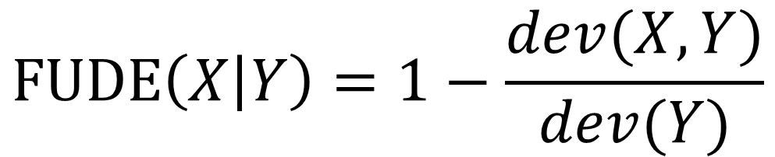
Fraction of unique deviance explained (FUDE)

Slide 33
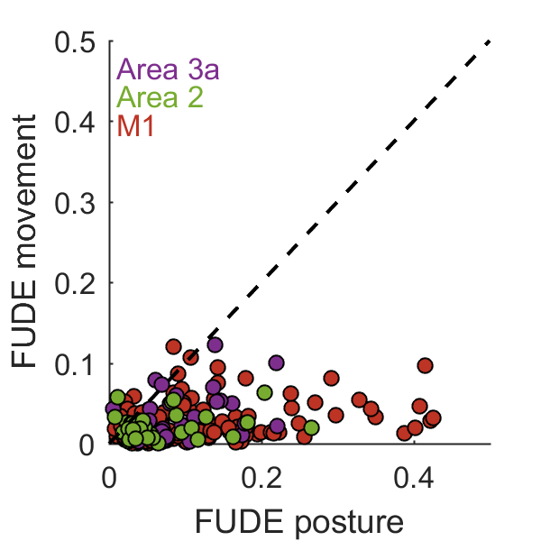
Neurons prefer postures over movements

Slide 34
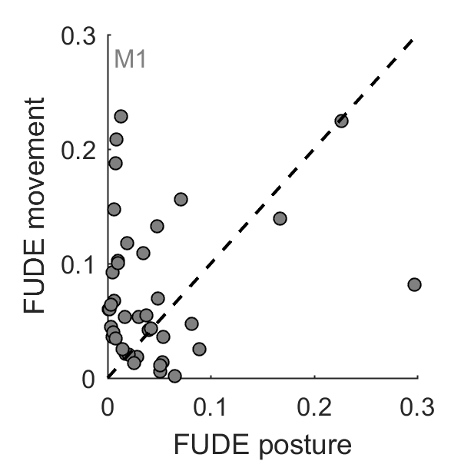
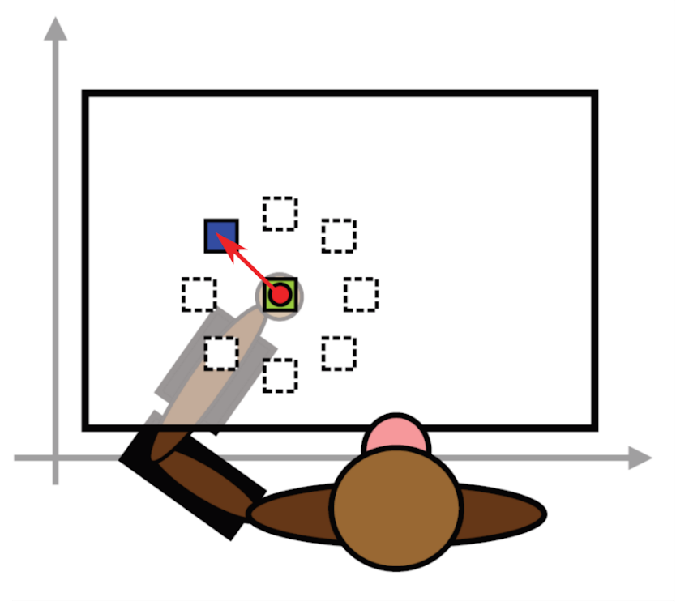
During reach, movements are preferred
Notes:
Different experiment

Slide 35
Discussion and Conclusions

Slide 36
Summary of results
Large RFs
No simple preferred coordinate frame
Posture, not movement
Sensory and motor are similar

Slide 37
Summary of results
Large RFs
No simple preferred coordinate frame
Posture, not movement
Sensory and motor are similar

Slide 38
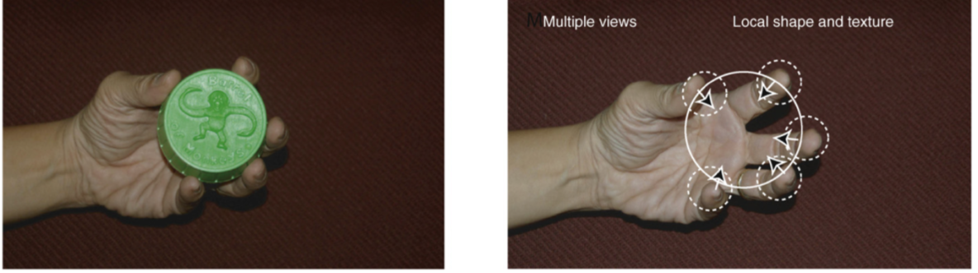
Stereognosis

Slide 39
Summary of results
Large RFs
No simple preferred coordinate frame
Posture, not movement
Sensory & motor are similar

Slide 40
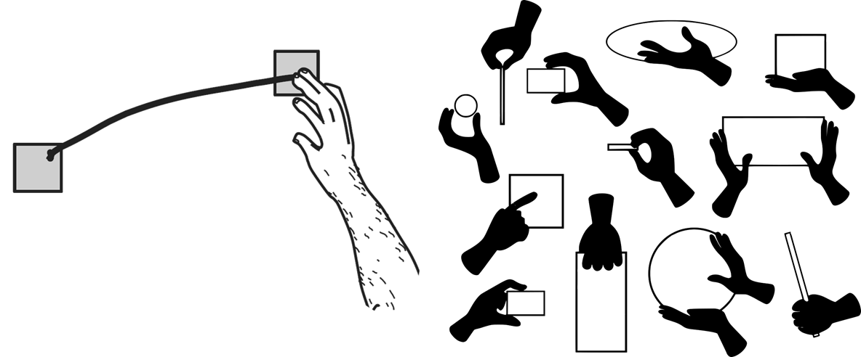
Arm and hand are different

Slide 41
Summary of results
Large RFs
No simple preferred coordinate frame
Posture, not movement
Sensory and motor are similar

Slide 42
Sensory-motor communication

Slide 43
Thank you

